Slide 1
Unit II
Veerendra Shrivastava

Slide 2
Syllabus
Computer Peripherals: various external peripherals and interfaces, Disk Drives – Hard Disk Drive (HDD) and Solid State Drive (SSD); Disk Controllers and Interfaces – IDE, SATA, SCSI, Keyboards – Types, Functioning and Interfacing. Printers, Display Monitors, Video Display adapters: VGA/SVGA, DVI/HDMI etc. Principle of operation of other Peripheral Devices: Optical Disks, Scanners, Mouse, Touch Screens, Flash Memory based storage devices. Firewire/USB

Slide 3
Storage Device
Internal
External

Slide 4
Disk Drives
A disk drive is a device that reads and/or writes data to a disk.
In Disk Drive data is recorded by various electronic, magnetic, optical, or mechanical changes to a surface layer of one or more rotating disks.
While there are multiple types of disk drives, they all work in a similar fashion.
Each drive operates by spinning a disk and reading data from it using a small component called a drive head. Hard drives and removable disk drives use a magnetic head, while optical drives use a laser.

Slide 5
Types of Disk Drives
Hard Disk Drive (HDD)
Solid State Drive (SDD)
Floppy Disk Drive (FDD)
Optical Disk Drive (ODD)

Slide 6
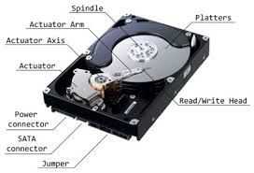
Hard Disk Drive

Slide 7
Working
https://animagraffs.com/hard-disk-drive/
Read more: https://www.youtube.com/watch?v=NtPc0jI21i0

Slide 8
Disk Controller
A hard disk controller (HDC) is an electrical component within a computer hard disk that enables the processor or CPU to access, read, write, delete and modify data to and from the hard disk.
Essentially, an HDC allows the computer or its processor to control the hard disk.
The disk controller is the controller circuit which enables the CPU to communicate with a hard disk, floppy disk or other kind of disk drive.
Also it provides an interface between the disk drive and the bus connecting it to the rest of the system.

Slide 9
A hard disk controller's primary function is to translate the instructions received from the computer into something that can be understood by the hard disk and vice versa. Read/Write
It consists of an expansion board and its related circuitry, which is usually attached directly to the backside of the hard disk.
The instructions from a computer flow through the hard disk adapter, into the hard disk interface and then onto the HDC, which sends commands to the hard disk for performing that particular operation.
Typically, the type and functions of a hard disk controller depend on the type of interface being used by the computer to access the hard disk.
For example, an IDE hard disk controller is used for IDE interface based hard disks.

Slide 10
There are many types of hard disk controller, but the basic components and the operating principle are approximately the same.
It consists of control logical circuit connected to a computer system bus, microprocessor, decoding and encoding circuit used to accomplish the separation of read-in data and compensation of write-in data, data error detection and correction circuit, logical circuit used for controlling the data transmission, serial and parallel conversion as well as formatting in accordance with the computer orders, read-only memory used for storing basic input and output program of disk and buffer for data exchange etc.

Slide 11
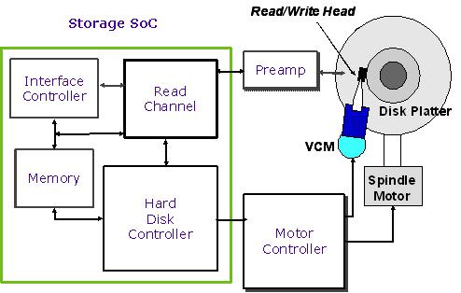

Slide 12
Hard Disk Interfaces
The hard disk interface defines the physical and logical means by which the hard disk connects to the PC.
In the 1980s, the most popular disk interfaces were ST506/412 and ESDI, which are now obsolete.
These old drives use two ribbon cables (a 20-pin data cable and a 34-pin control cable).

Slide 13
Hard Disk Drive Interfaces
IDE/ATA-1 133 or PATA ( Integrated Drive Electronics) -3.3MB/S
SATA (Serial Advanced Technology Attachment)
SCSI(Small Computer System Interface) – More than one HDD
SAS(Serially Attached SCSI) – Servers/Workstation - GB
Differences between Interfaces based on:
Speed
Uses
Cost
Number of Pins
Serial/Parallel

Slide 14
Integrated Drive Electronics
IDE was by the most common hard disk interface used in PCs from the early 1990s through 2003.
IDE is officially designated ATA, but is now often informally called Parallel ATA or PATA, to differentiate it from the new Serial ATA (SATA) interface.
Early hard disk interfaces used a separate hard disk and controller card, which limited throughput.
In 1986, Compaq and Western Digital combined the hard disk and controller card into one unit, thereby inventing IDE.
IDE/ATA/PATA – ATA-1 to ATA-133 – Parallel Mode – Slow - interference

Slide 15
SATA
Serial ATA (SATA) is a new technology that will ultimately replace parallel IDE/ATA. Fast
SATA has several advantages over PATA, including superior cabling and connectors, higher bandwidth, and greater reliability.
Although SATA and PATA are incompatible at the physical and electrical levels, adapters are readily available that allow SATA drives to be connected to PATA interfaces and vice versa.
SATA is fully compatible with PATA at the software level, which means that the ATA drivers supplied with current operating systems work equally well with either SATA or PATA interfaces and drives.

Slide 16
SCSI
SCSI(Small Computer Small Interface) hard disks are generally used in servers and high-end workstations, where they provide two major advantages: improved performance relative to IDE and SATA in multitasking, multiuser environments, and the ability to daisy-chain many drives on one computer.
SCSI interfaces are available in various subtypes, which have different physical and electrical interfaces and transfer rates.
Modern SCSI hard disks are the largest, fastest disks available, although recently IDE and SATA hard disks have begun to approach SCSI in size and speed.

Slide 17
SAS
SAS(Serially Attached SCSI) is generally more expensive, and it’s better suited for use in servers or in processing-heavy computer workstations.
The higher speeds and a higher level of resilience make SAS the obvious choice for Enterprise use and in situations where high speed and reliability are paramount.
SAS hard drives come in 2 main types: 10K and 15K. The K refers to the rotational speed of the hard drive, i.e. 10,000 and 15,000 revolutions per minute respectively.

Slide 18
Video Display Adapters
VGA ( Video Graphic Array )
SVGA ( Super Video Graphic Array )
UVGA(Ultra Video Graphic Array)

Slide 19
Other Topics
Types of Keyboards
Mouse
Monitors
Touchscreen

